Slide 1
Network Visualization and Analysis of International Trade Flows - Lakshmi pavani raghavaraju

Slide 2
Project definition
This project aims to map and analyze global trade routes by representing countries as nodes and their trade relationships as edges in a network, using international trade data such as import/export volumes and trade agreements. Through network visualization and analysis, the project seeks to uncover economic connections, trade strengths, and dependencies, providing insights into global trade patterns and opportunities for economic growth.

Slide 3
Nodes and Edges
This project represents global trade networks through nodes and edges to understand the structure and dynamics of international trade.
Nodes: Each node corresponds to a country, uniquely identified by its geographical properties, such as latitude and longitude. These geographical attributes provide spatial context to the network, enabling visualizations that align with real-world geography. By mapping nodes accurately, the project ensures that the trade network reflects the global distribution of countries and their physical proximity, which often influences trade relationships.
Edges: Directed and weighted edges connect the nodes, representing trade relationships between countries. A directed edge from country A to country B indicates that A exports goods or services to B. The weight of an edge quantifies the trade volume between the two countries, measured in US dollars, allowing the analysis of trade intensity and economic impact. This structure makes it possible to identify major exporters, importers, and trade hubs, as well as assess bilateral trade dependencies and imbalances.

Slide 4
Data and Data Sources
The project leverages publicly available datasets to construct the global trade network:
Trade Data: Trade volumes and relationships are derived from a dataset generated using data from the World Trade Organization (WTO). This dataset includes details such as import/export values, trade flows, and product categories, providing a robust foundation for analysing global economic connections.
Country Coordinates: Geographical properties of countries, including latitude and longitude, are obtained from a publicly available dataset (API). This data ensures the accurate placement of nodes on the network visualization, aligning the trade network with real-world geography for improved spatial analysis and interpretation.

Slide 5
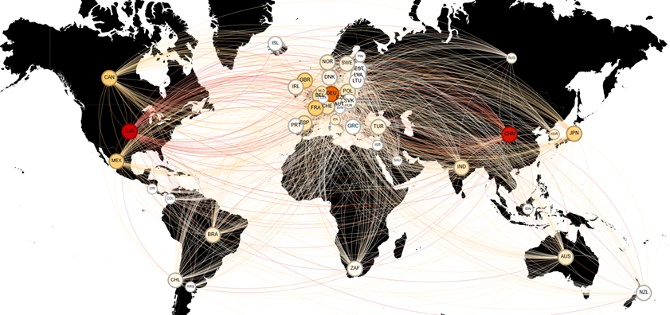
Tool Selection: Gephi tool is an excellent tool for visualising and analyzing the global trade network. It allows you to work with large network datasets and provides various features for layout optimization, clustering, and community detection.

Slide 6
Network Visualization Based on Degree Centrality
Node Color:
Represents weighted degree centrality, calculated based on the total trade volume (sum of both incoming and outgoing trade values) in million dollars.
Nodes with higher trade volumes are assigned darker colors, highlighting countries that play a significant role in global trade activity, irrespective of the number of trade connections they maintain.
Node Size:
Represents degree centrality, calculated as the total number of connections (trade partners) a country has.
Larger nodes indicate countries with extensive trade relationships, emphasizing their centrality in the trade network due to a greater number of trade partnerships.

Slide 7

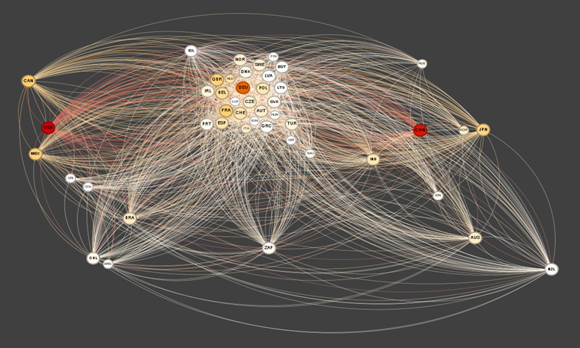
Network Visualization Based on Degree Centrality
USA and CHN

Slide 8
Clustering Analysis Based on Modularity
The network was clustered using modularity-based clustering to identify groups of countries with dense internal trade connections and sparse connections to other clusters.
Modularity: 0.194 - This indicates a moderate level of community structure, suggesting that while there are distinct clusters, the network still has significant interconnections.
Modularity with Resolution Adjustment: -0.015 - Adjusting the resolution slightly decreased modularity, suggesting fewer well-defined clusters at this scale.
The network consists of 6 communities, each representing a distinct cluster of countries with higher trade connectivity within the group.
Colors in the network visualization represent different communities.
This helps highlight regional trade blocs or economic alliances, as countries within the same community tend to have stronger trade ties with each other.

Slide 9
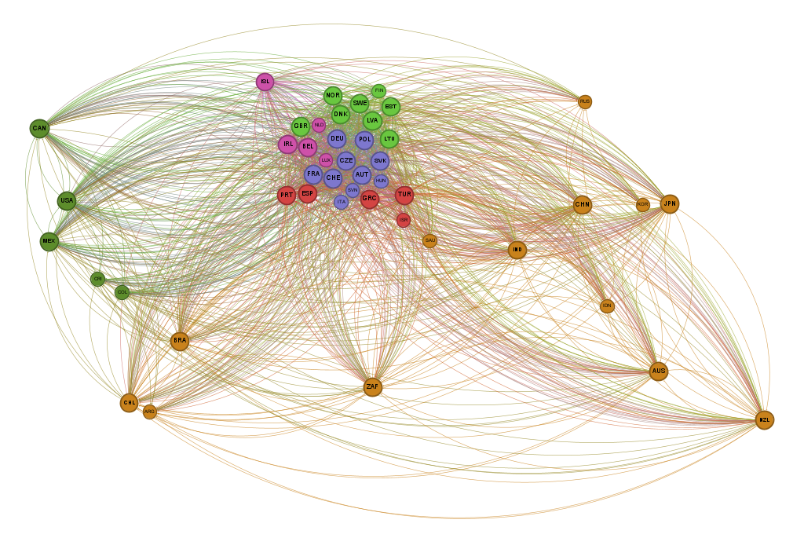
Clustering Analysis Based on Modularity
Green: Includes countries like the USA, Canada, and Mexico.
Purple: Focused around European nations like Belgium and Ireland.
Yellow: Includes countries from South America, Asia, and Oceania like China, India, and Brazil.

Slide 10
Homophily in Network Visualization
Homophily refers to the tendency for similar nodes to connect in a network, often resulting in communities or clusters based on shared attributes or behaviors.
Evidence of Homophily:
In this network visualization, homophily is visible through the clustering of nodes with similar colors (modularity classes).
Observations in the network:
Green nodes are primarily clustered on the left side.
Red and blue nodes form a dense cluster in the center.
Orange nodes are spread towards the bottom-right.
These color-coded clusters suggest that nodes within the same modularity class have more connections among themselves, indicating homophily.

Slide 11
Network Visualization Based on Centrality Measures
Visualization Focus:
This visualization highlights the importance of each country in terms of its trade network influence and connectivity.
Node Color - Betweenness Centrality:
Color of nodes is based on betweenness centrality.
Nodes with a higher betweenness centrality are colored more intensely, indicating they act as critical bridges in trade routes between other countries.
These nodes represent countries that facilitate trade flow across different regions, making them influential in connecting multiple trade partners.
Node Size - Eigenvector Centrality:
Size of nodes is based on eigenvector centrality.
Nodes with larger sizes have higher eigenvector centrality, meaning they are to other influential countries.
This reflects a country’s influence within the global trade network, as countries with high eigenvector centrality tend to have strong connections with other high degree countries.

Slide 12
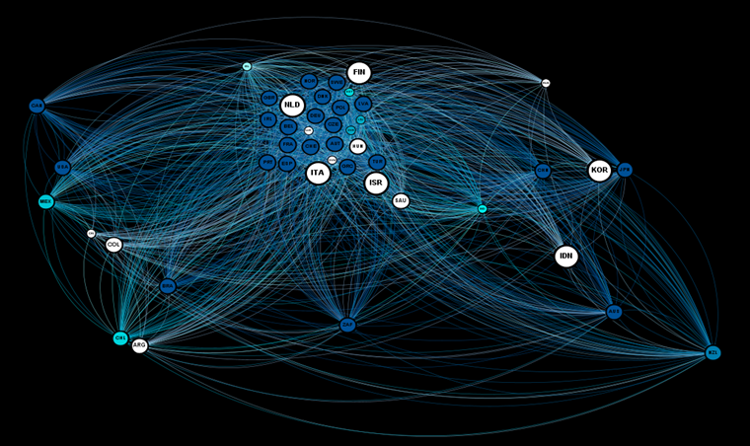
The large nodes with light colors have high eigenvector centrality but low betweenness centrality. This suggests they are influential and well-connected within a core cluster of similar nodes but don't serve as crucial bridges between distant parts of the network. (Eg. Korea) conversely, nodes with higher betweenness centrality (darker color) might be smaller because they connect distinct clusters but don't necessarily have direct connections to many influential nodes. (Eg. South africa)

Slide 13
Strongly Connected Components Analysis
Largest SCC:
ID: 14, accounting for 69.57% of the network nodes.
Represents the largest cohesive substructure in the network where all nodes can mutually reach each other following edge directions.
Other SCCs:
14 smaller SCCs (IDs: 0 to 13), each contributing 2.17% of nodes to the network.
These smaller SCCs represent isolated subgraphs or regions of limited mutual connectivity.
Insights:
The dominance of one large SCC (69.57%) indicates a high level of connectivity in the network, where most nodes belong to a single strongly connected region.
The smaller SCCs suggest the presence of disconnected or weakly integrated components in the overall network.

Slide 14
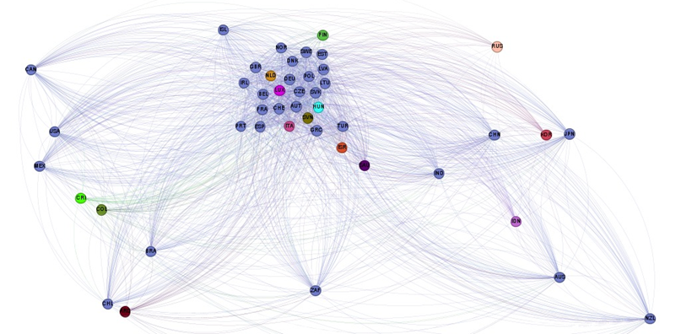
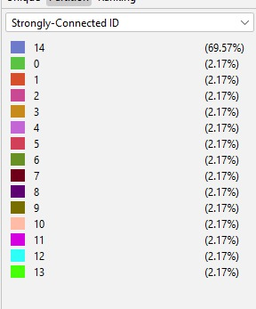

Slide 15
Network Visualization with Clustering Coefficient, Closeness Centrality, and Edge Weight
Node Properties:
Color of the Node:
Indicates the average clustering coefficient of each node.
Nodes with higher clustering coefficients are more tightly connected within their local neighborhood, representing regions with stronger community structures.
Color gradient helps identify which areas of the network exhibit dense connectivity (high clustering).
Size of the Node:
Represents harmonic closeness centrality.
Larger nodes indicate higher closeness centrality, meaning these nodes are central in the network and have shorter average distances to all other nodes.
Edge Properties:
Edge Thickness:
Proportional to the weight of the edge (e.g., trade volume in the dataset).
Thicker edges signify higher interactions or stronger relationships between nodes.

Slide 16
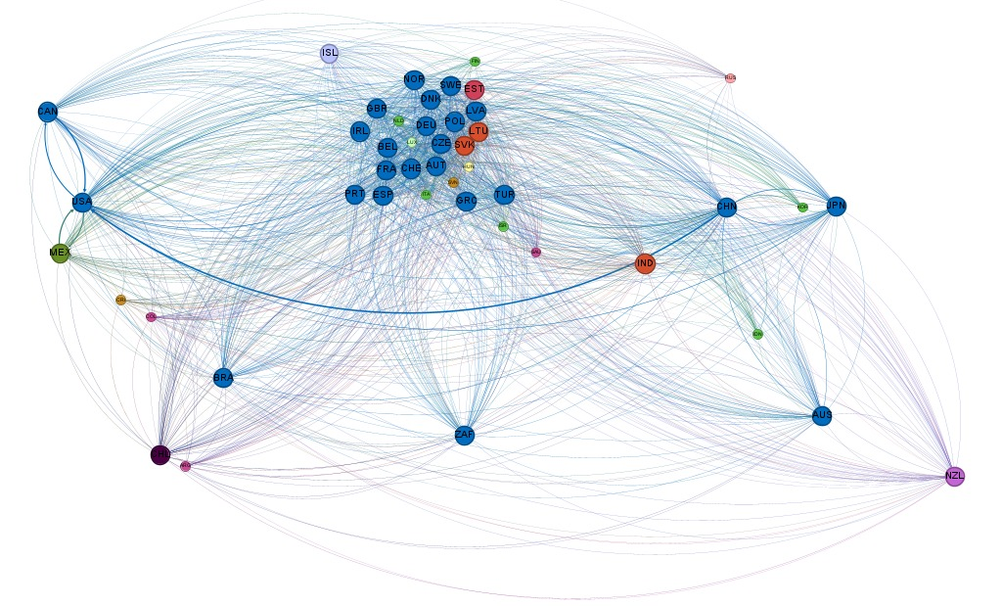
Clusters with high clustering coefficients are visually distinct due to node color intensity, highlighting areas of strong local connectivity.
Central nodes (large-sized nodes) with high harmonic closeness centrality indicate key nodes that act as efficient connectors across the network.
Heavily weighted edges (thicker lines) demonstrate significant relationships, such as high trade volume or other weighted interactions.

Slide 17
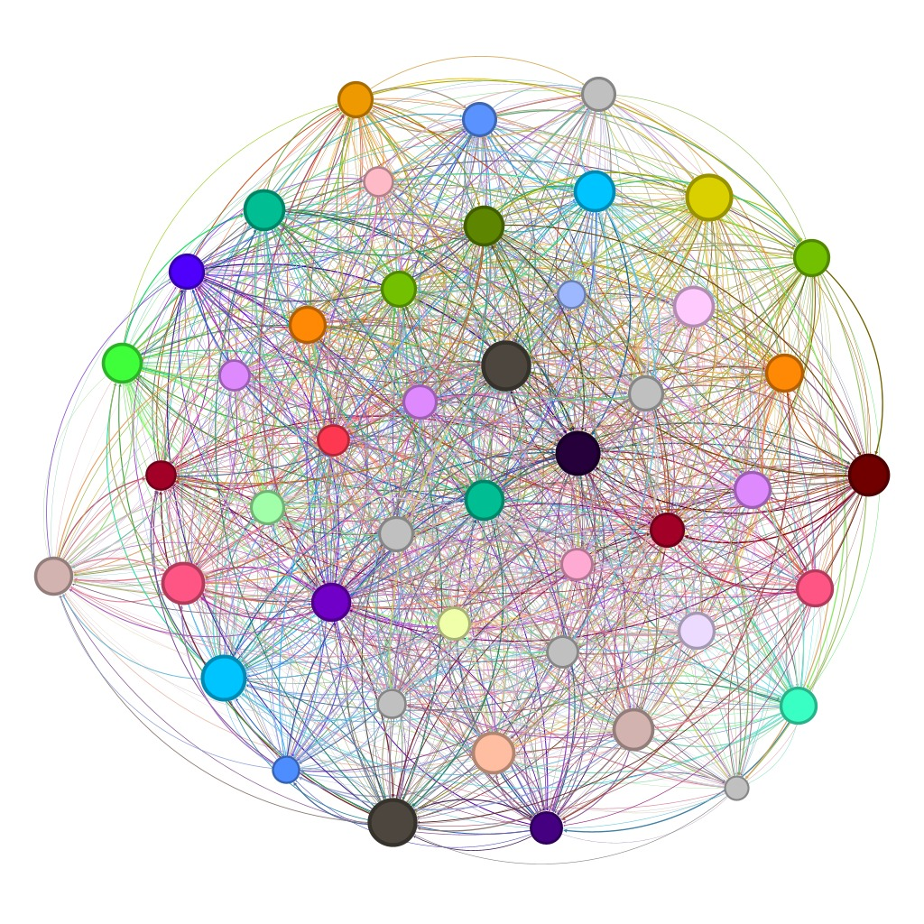
Randomness
This analysis compares our trade network with random graph model (Erdős–Rényi with random weights).
Degree distribution in the trade network follows a power-law, unlike the distribution of the ER model. These deviations indicate non-randomness in trade relationships, driven by factors like geographical proximity and economic ties.
Original Network:
High clustering and modularity indicate strong community structures.
Weighted degrees reveal disparities in trade importance among nodes.
Shorter path length highlights efficient trade or communication flow.
Random Network:
Lower clustering and modularity demonstrate a lack of community structure.
Weighted degree distribution is uniform, lacking real-world trade dynamics.

Slide 18
RESULTS:
Global Trade Connectivity: Most countries are highly interconnected, with 69.57% of them forming a single large trade group, showing the global nature of trade networks.
Key Players: Countries like China and the USA stand out due to their high trade volumes and many connections, making them central to the global trade network.
Regional Alliances: Clustering reveals regional trade groups like the EU and ASEAN, where countries trade more within their groups than with others.
Trade Influencers vs. Connectors: Some countries, like Korea, are influential within their clusters but don’t bridge different regions. Others, like South Africa, act as connectors between distinct clusters.
Non-Random Patterns: Trade relationships are shaped by factors like geography and economy, unlike random networks. Real-world trade shows stronger community structures and key hubs.
Efficient Trade Paths: Central countries have short trade paths to others, ensuring efficient flow of goods and resources.

Slide 19
Thank you

